Slide 1
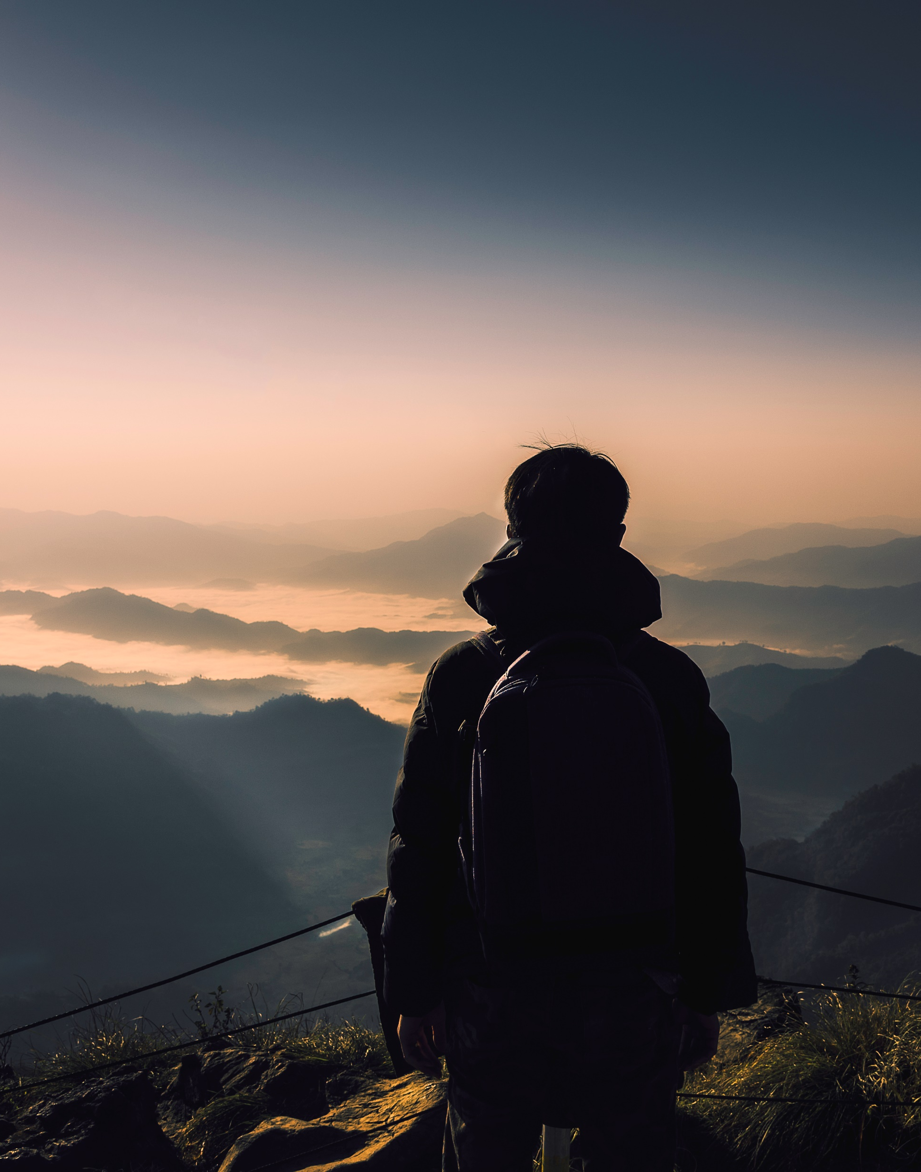
Boston travels
Arun BALASUBRAMANIAN: 002793413
SRUTHI SIVASANKAR: 002793262
DARSHAN PRAMOD NEMADE: 002790266
HARISH RAO T: 002704549

Slide 2

Table of content
DESCRIPTION
TECH STACK
USER
IMPLEMENTATION

Slide 3

Description
Boston Travels is a travel website, where users can book and explore different travel packages.
The website has user authentication which is login and signup.
The website includes webpages like:
Sign Up
Login Page
Home
Packages
About
Contact Us

Slide 4

Tech Stack
MongoDB – For Database
Bootstrap – For Dynamic and responsive website
NodeJS, Express – For Backend Connection
CSS – For Styling
ReactJS, HTML, JavaScript – For Frontend
This Photo by Unknown author is licensed under CC BY.

Slide 5

Users
Multiple users can sign up and login.
Users can explore different packages to choose from.
Users can find a suitable package according to their like.
Users can reach out using the Contact Us section in the website.
This Photo by Unknown author is licensed under CC BY-NC-ND.

Slide 6
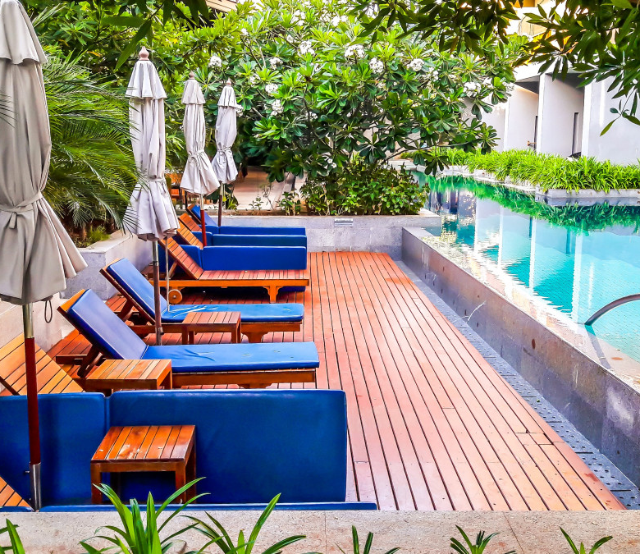
Implementation

Slide 7

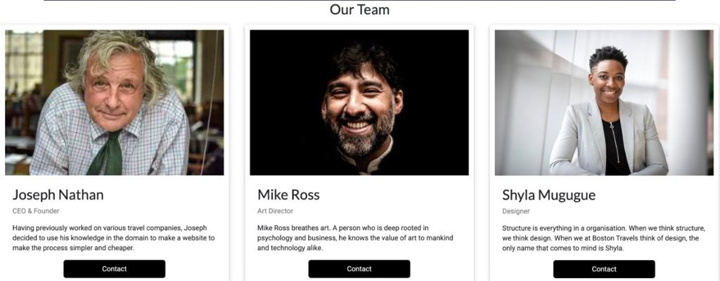
About page

Slide 8

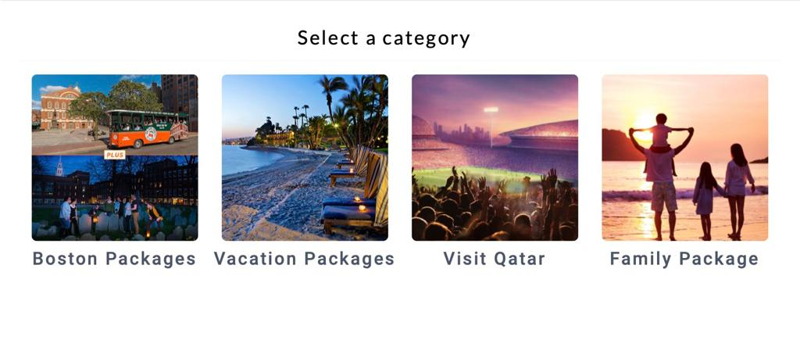
Packages

Slide 9
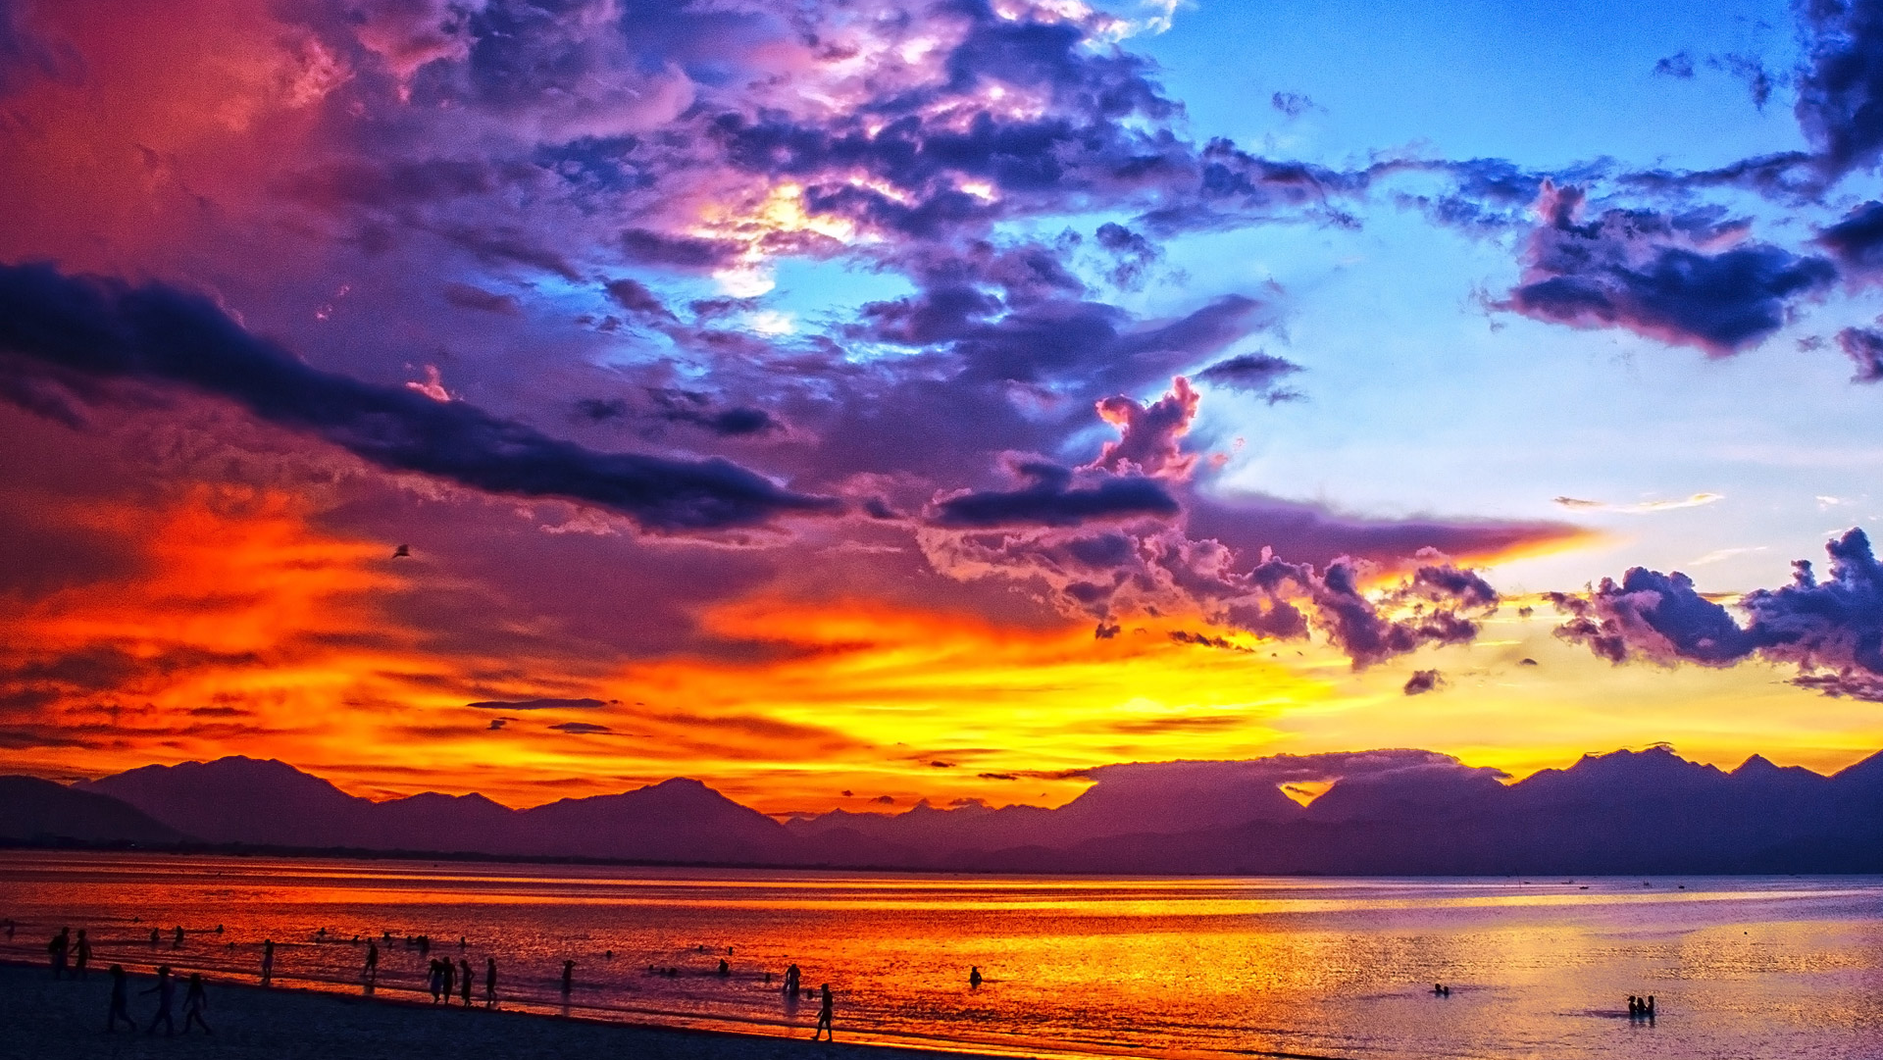
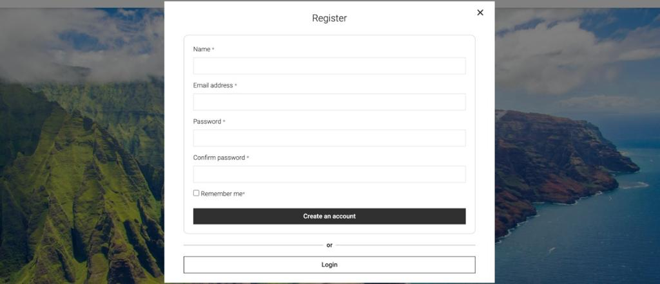
Register page

Slide 10

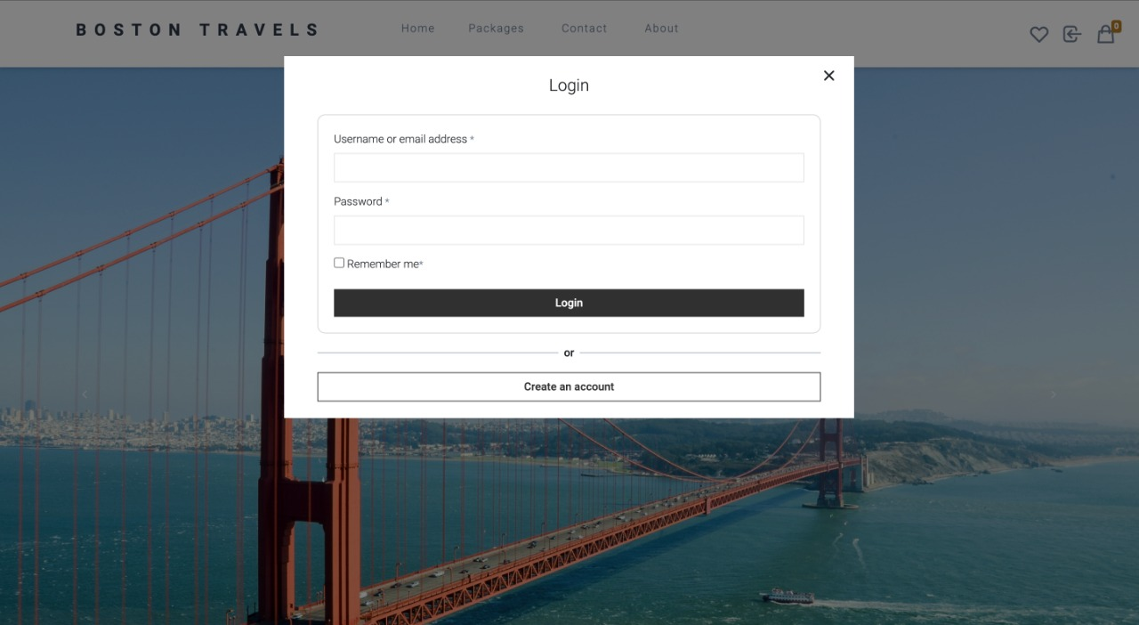
Login page

Slide 11

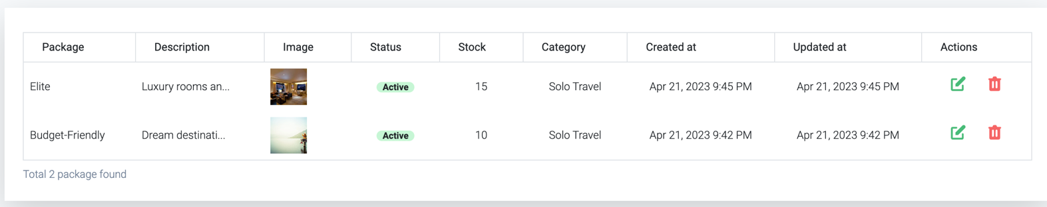
Orders

Slide 12
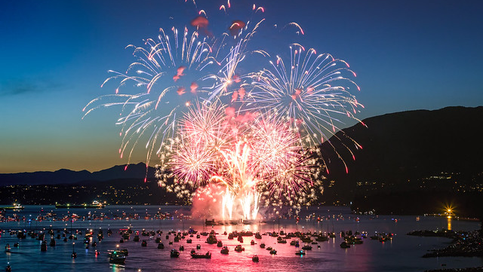
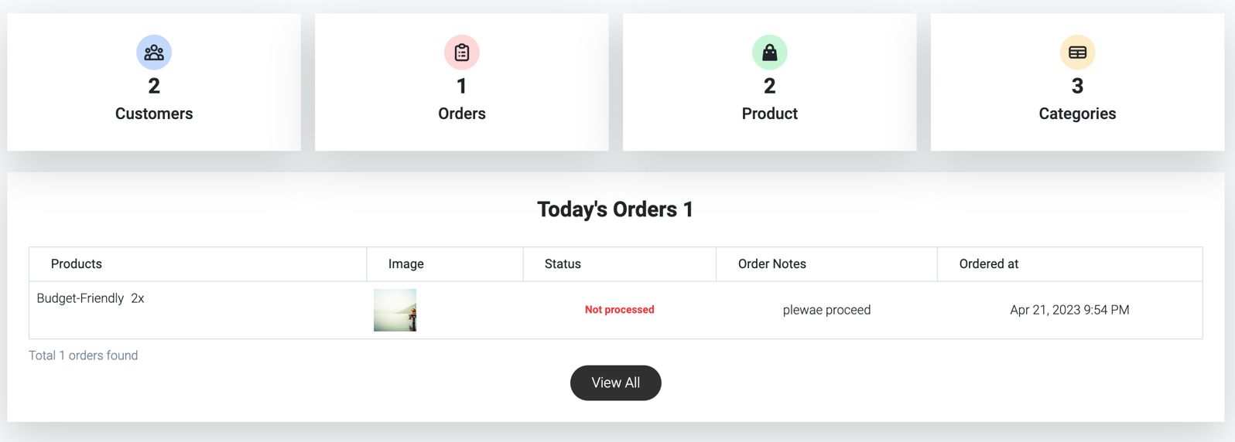
Admin PANEL
This Photo by Unknown Author is licensed under CC BY-SA-NC

Slide 13

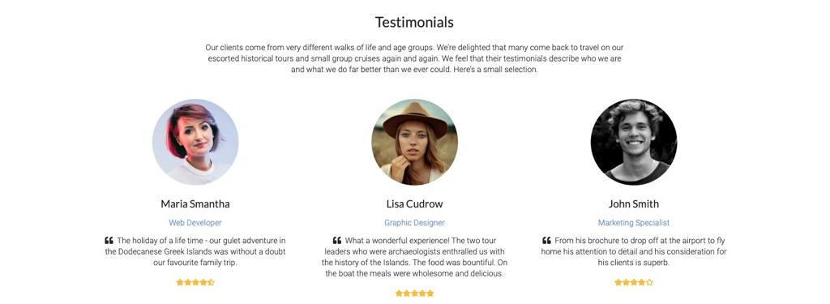
Testimonials

Slide 14
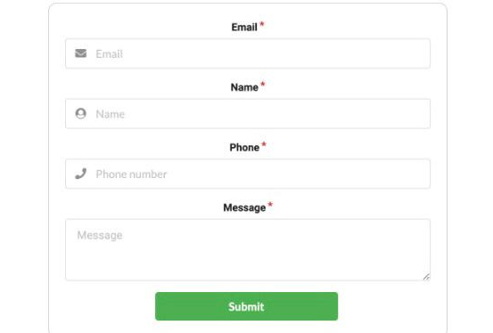

Contact page

Slide 15

Thank you
This Photo by Unknown Author is licensed under CC BY-NC-ND

